Slide 1
안드로이드
3). Fragment in Navigation

Slide 2
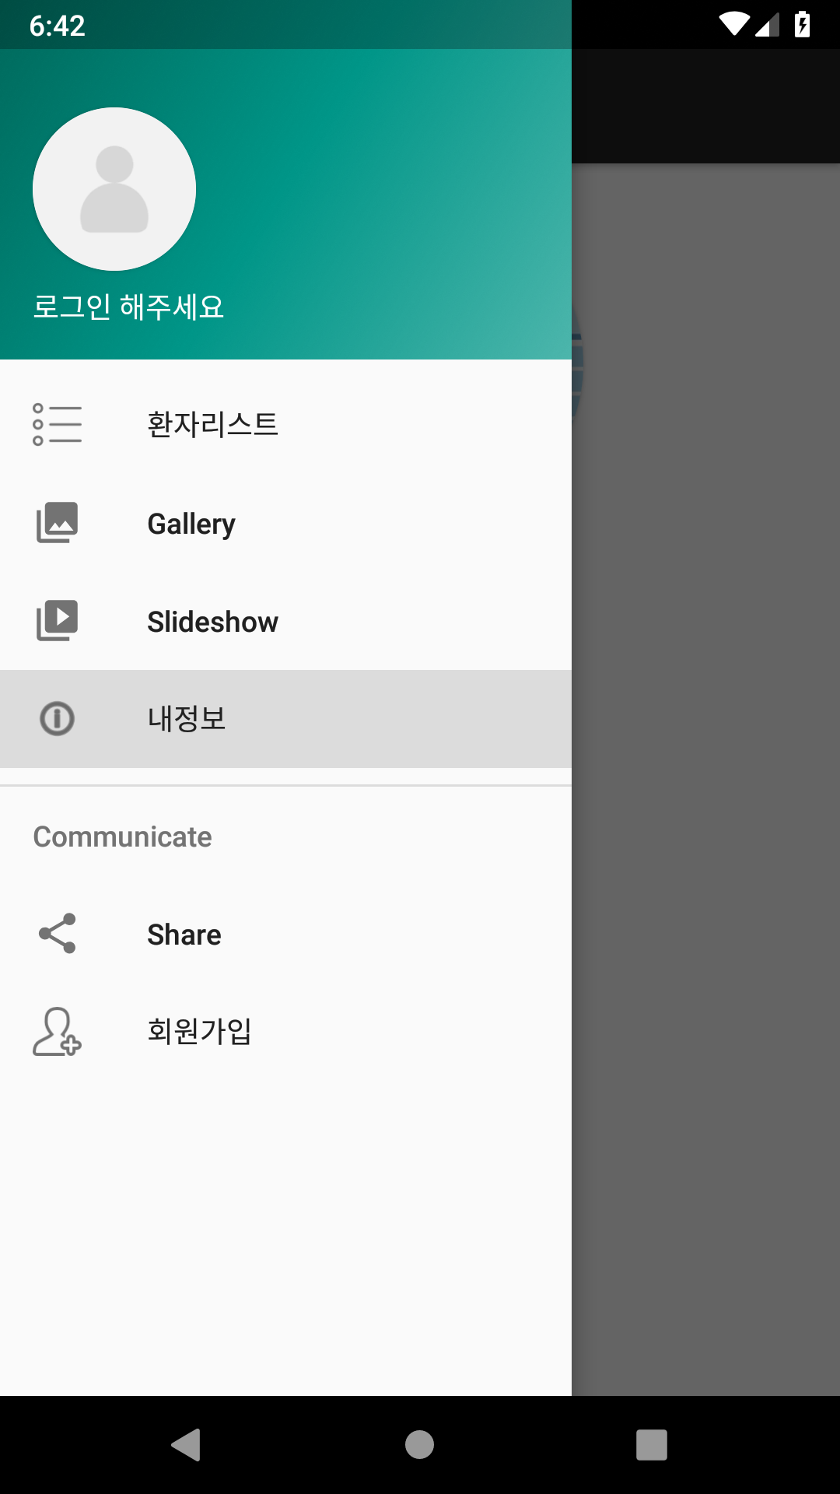
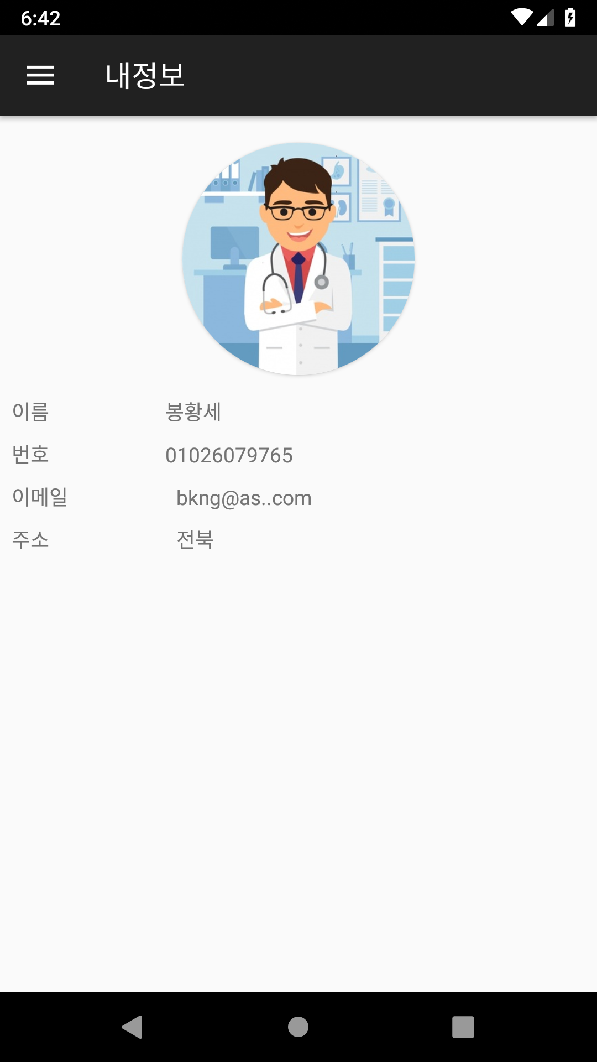
Navigation 을 이용한 화면전환

Slide 3
1). MainActivity.java 에서 시작하기
@Override public boolean onNavigationItemSelected(MenuItem item) {
FragmentTransaction fragmentTransaction = getSupportFragmentManager().beginTransaction();
Fragment fragment = new MyInfoFragment();
if(fragment != null){ fragmentTransaction.replace(R.id.content_main , fragment); fragmentTransaction.commit(); }
DrawerLayout drawer = (DrawerLayout) findViewById(R.id.drawer_layout);
drawer.closeDrawer(GravityCompat.START); return true;
}

Slide 4
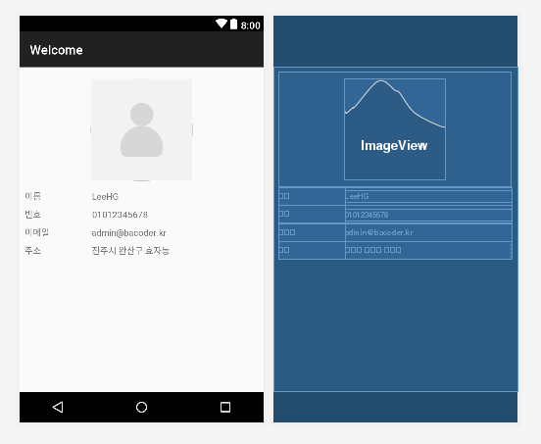
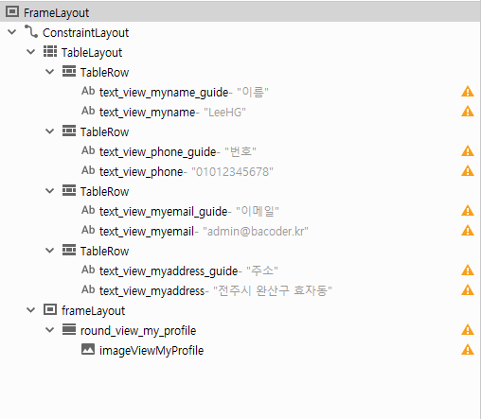
2). fragment_my_info.xml

Slide 5
3). MyInfoFragment.java
public class MyInfoFragment extends Fragment { private final static String TITLE = "내정보"; @BindView(R.id.imageViewMyProfile) ImageView _myProfile; @BindView(R.id.text_view_myaddress) TextView _myAddress; @BindView(R.id.text_view_myemail) TextView _myEmail; @BindView(R.id.text_view_phone) TextView _myPhone; @BindView(R.id.text_view_myname) TextView _myName; private final String TAG = MyInfoFragment.class.getSimpleName();
}

Slide 6
3-1). Fragment 생명주기
onCreate() : fragment 초기화
onCreateView() : fragment 와 view 만듦
onResume() : 사용자와 상호작용 할 수 있을 때 호출됨

Slide 7
3-2). onCreate() : 화면이 처음 생성될때
private static final String ARG_PARAM1 = "param1"; private static final String ARG_PARAM2 = "param2"; private String mParam1; private String mParam2;
public static MyInfoFragment newInstance(String param1, String param2) { MyInfoFragment fragment = new MyInfoFragment(); Bundle args = new Bundle(); args.putString(ARG_PARAM1, param1); args.putString(ARG_PARAM2, param2); fragment.setArguments(args); return fragment; } @Override public void onCreate(Bundle savedInstanceState) { super.onCreate(savedInstanceState); if (getArguments() != null) { mParam1 = getArguments().getString(ARG_PARAM1); mParam2 = getArguments().getString(ARG_PARAM2); } }

Slide 8
3-3). 이전화면으로부터 parameter 가져오기
1). MainActivity.java 에서 시작하기를 다시 본다.
@Override public boolean onNavigationItemSelected(MenuItem item) {
FragmentTransaction fragmentTransaction = getSupportFragmentManager().beginTransaction();
Fragment fragment = new MyInfoFragment();
Bundle args = new Bundle(); args.putString("param1", "01026079765"); args.putString("param2", "12355"); fragment.setArguments(args);
if(fragment != null){ fragmentTransaction.replace(R.id.content_main , fragment); fragmentTransaction.commit(); }
DrawerLayout drawer = (DrawerLayout) findViewById(R.id.drawer_layout);
drawer.closeDrawer(GravityCompat.START); return true;
}

Slide 9
3-4). onCreateView() : xml 화면을 inflate 한다
@Override public View onCreateView(LayoutInflater inflater, ViewGroup container, Bundle savedInstanceState) { View view = inflater.inflate(R.layout.fragment_my_info, container, false); ButterKnife.bind(this, view); setView(mParam1, mParam2); return view; }

Slide 10
3-5). onResume() : fragment 제목을 변경한다
@Override public void onResume() { super.onResume(); ((MainActivity)getActivity()).getSupportActionBar().setTitle(this.TITLE); }

